Slide 1

Software Construction

Slide 2
Overview
Marks Distribution
Introduction to software construction
Process Models

Slide 3
Course outline & Marks Distribution
Quizzes 4 – each of 2.5 marks
Assignments 4 - each of 5 marks
Midterm
Final Term

Slide 4
Introduction to Software Construction
Software construction is a software engineering discipline that lays the foundation for understanding the principles, practices, and processes involved in building high-quality software
It is the detailed creation of working meaningful software through a combination of
Concepts
SDLC
Development Methodologies
Programming concepts: Coding/ Verification/ Unit testing/ Integration testing/ Debugging
Version controlling
Testing
SPM
It is linked to all the other software engineering disciplines, most strongly to software design, software testing, software quality assurance and project management.

Slide 5
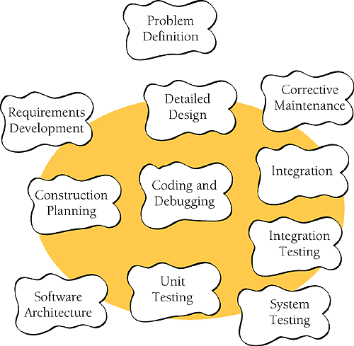

Slide 6
Software construction fundamentals
These examples illustrate how each of these principles plays a role in software construction, helping to improve code quality, maintainability, and efficiency in the development process.
Minimizing complexity
Anticipating change
Constructing for verification
Reuse
Standards in construction

Slide 7
Minimizing Complexity:
Illustration: Imagine you're building a software program to calculate the average temperature for a given set of cities. Instead of creating a single, monolithic function with a complex algorithm, you break it down into smaller, more manageable functions.

Slide 8
def calculateAverage(temperatures):
# Complex code here to calculate average
pass
def getTemperatures(city):
# Code to fetch temperature data for a city
pass
def main(cityList):
for city in cityList:
temperatures = getTemperatures(city)
avg = calculateAverage(temperatures)
print(f"The average temperature in {city} is {avg}")

Slide 9
Anticipating Change:
Illustration: You're developing a mobile app with a settings menu. Instead of hardcoding the settings, you create a dynamic settings framework that allows for easy additions or changes to settings options.

Slide 10
Example
struct AppSettings {
var notificationsEnabled: Bool
var darkModeEnabled: Bool
var fontSize: Int
// More settings can be added in the future
}

Slide 11
Constructing for Verification:
Illustration: You're building a function to validate email addresses. You construct it with verification in mind, making it modular and easy to test by creating separate test cases.
def is_valid_email(email):
# Validation logic here pass

Slide 12
Cont…
def test_email_validation(): assert is_valid_email("user@example.com") == True assert is_valid_email("invalid_email") == False assert is_valid_email("another@example.com") == True

Slide 13
Reuse:
Illustration: You're developing a web application with a user authentication system. Instead of reinventing the wheel, you use a third-party authentication library, which saves development time and leverages well-tested code.
Example: Incorporating a library like Passport.js for authentication in a Node.js application.

Slide 14
Standards in Construction:
Illustration: You're working on a team project, and everyone follows a coding standard. This ensures consistency and readability across the codebase, making it easier for team members to understand and maintain each other's code.
Example: Consistently using the PEP 8 style guide for Python code, including conventions for indentation, naming, and commenting.

Slide 15
Managing construction
Construction model
Construction planning
Construction Measurement

Slide 16
Construction Model:
Imagine you're tasked with building a new residential complex. Before any physical construction begins, you create a detailed architectural model. This model includes floor plans, elevations, and 3D renderings. It serves as a visual representation of the final product, allowing stakeholders to review and approve the design before actual construction starts.

Slide 17
Construction Planning:
For a large-scale commercial project, you would engage in comprehensive planning. This involves creating a detailed project schedule, allocating resources, setting milestones, and identifying critical paths. You'll also consider factors like procurement of materials, permits, and hiring subcontractors. This planning phase ensures that the construction process runs efficiently and on schedule.

Slide 18
Construction Measurement:
In construction, accurate measurement is crucial. For instance, when installing windows in a building, precise measurements are taken to ensure they fit perfectly. Using tools like tape measures, laser levels, and plumb bobs, you measure dimensions, angles, and alignments to guarantee that each component is installed correctly.

Slide 19
Practical considerations
Construction design
Construction languages
Coding
Construction testing
Reuse
Construction quality
Integration

Slide 20
Construction technologies
Object-oriented runtime issues
Assertions, design by contract, and defensive programming
Error-handling, exception-handling, and fault tolerance
State-based and table-driven construction techniques
Runtime configuration and internationalization

Slide 21
Social Learning Process
Software is embodied knowledge that is initially distributed, unstated and incomplete.
In order to convert knowledge into software, dialogues are needed between users and designers, between designers and tools to bring knowledge into software.
Software development is essentially an iterative social learning process, and the outcome is “software capital”.

